Slide 1
Rural Roads and Economic Development
Sam Asher and Paul Novosad
Discussion by Jeff Denning

Slide 2
Many people do not live close to paved roads
~1 billion people more than 2km to nearest paved road.
This can pose big hurdles to economic development
Building roads may improve economic outcomes, but it also may not be enough to overcome other issues (e.g. lack of population density)

Slide 3
Policy
Pradhan Mantri Gram Sadak Yojana (PMGSY)
Launched in 2000
Connected smaller villages via roads
Prioritized roads to larger towns (1,000 people by 2003 etc)

Slide 4
Data
Treatment data comes from PMGSY website
Census Data (used to determine eligibility for social programs)
Predicted consumption using assets income and land
Firm Data
Satellite based data on agricultural output
In summary, a lot of data

Slide 5
Strategy
RD!
Uses the population thresholds
These were different in different settings (states, desert, tribal). Is that a problem?
Running variable is population relative to threshold
Fuzzy RD
What is the instrument? What are the assumptions

Slide 6
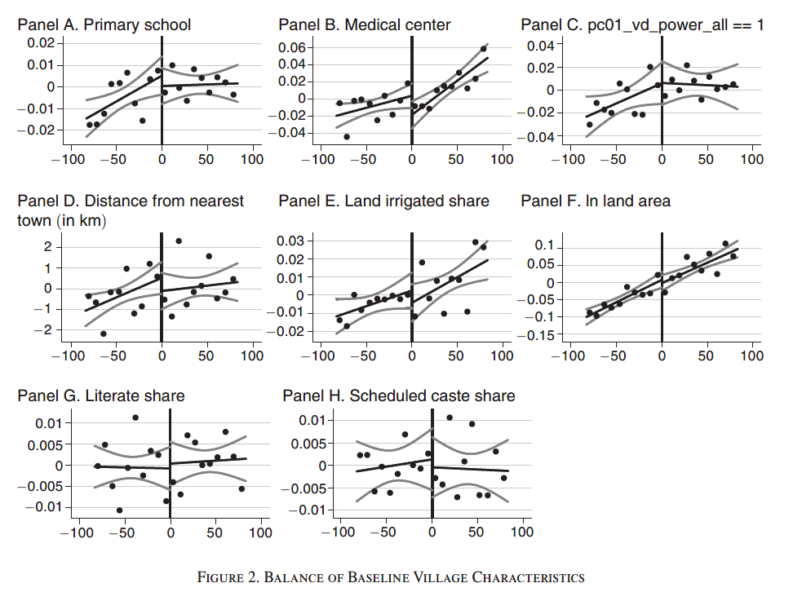
Balance of Characteristics

Slide 7
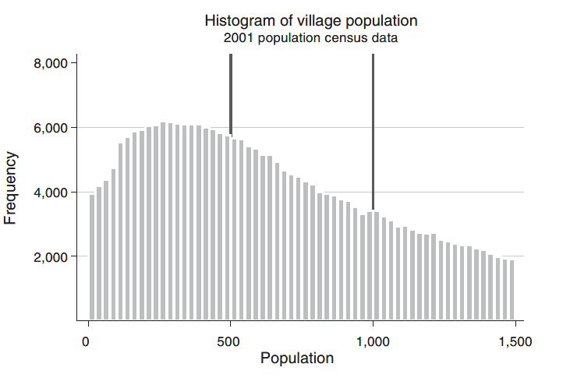
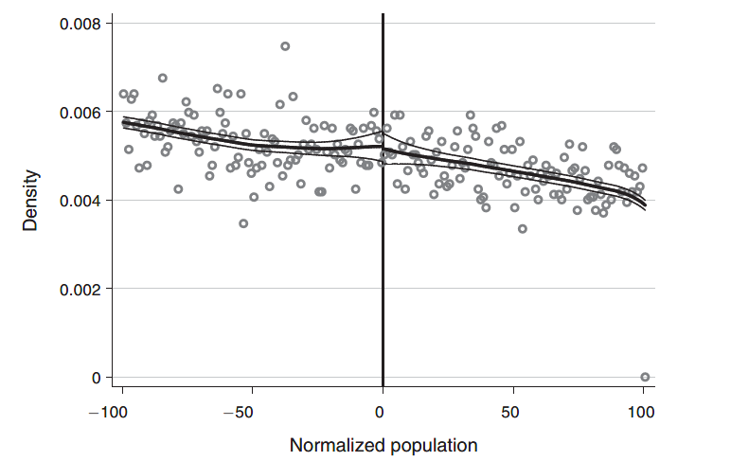
Density Check

Slide 8
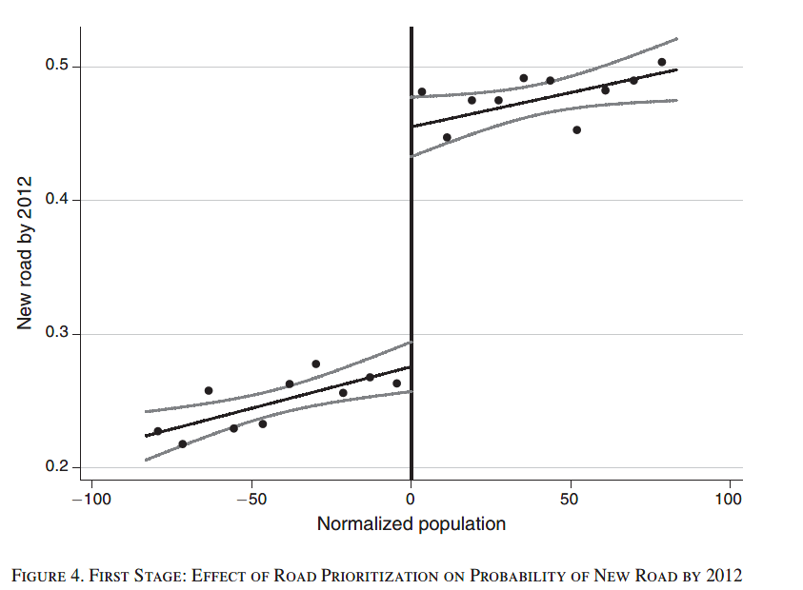
First Stage
Why is this fuzzy?
Is this common?
Is it surprising you can still get a causal estimate?
For which towns?

Slide 9
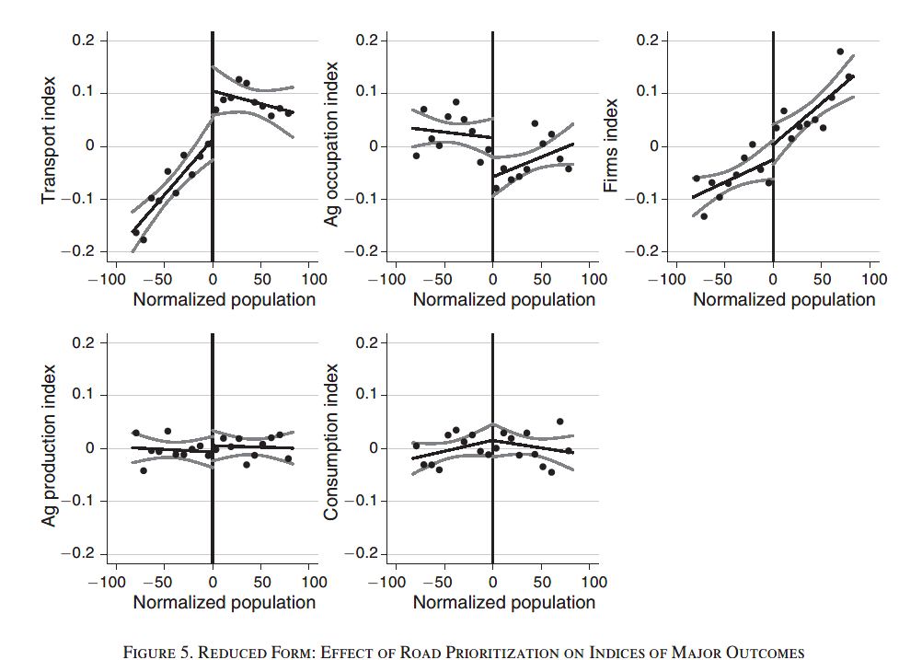
Reduced Form

Slide 10
Results
More likely to have bus services
Less likely to work in agriculture, more likely to work in manual labor
No effects on consumption
Small effects on local economic growth

Slide 11
Robustness
Effects in states that didn’t follow the rules
Different Bandwidths
Migration and population

Slide 12
Conclusion
Nice example of Fuzzy RD
Roads don’t seem to bring large economic benefits to small villages

